Slide 1

University Institute of Engineering
DEPARTMENT OF COMPUTER SCIENCE & ENGINEERING
Bachelor of Engineering (Computer Science & Engineering)
Subject Name : SEO
Subject Code: 20CST-463
Topic: Lecture-1.3.2
Lecture- SEO Tools
By : Sourabh Budhiraja
DISCOVER . LEARN . EMPOWER

Slide 2
Syllabus
UNIT-1: Introduction to SEO
CHAPTER-1: Introduction to Search Engine Optimization:
Introduction to search engine optimization, Basics of SEO, Keyword Research, On-Page Optimization, Technical SEO.
CHAPTER-2: Content Creation and SEO tools:
Content Creation for SEO, SEO Analytics, SEO Tools, Local SEO, SEO Ethics and Future Trends.

Slide 3
CONTENTS
SEO Tools

Slide 4
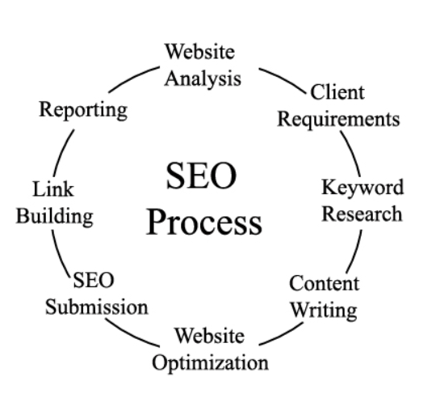
What is Search Engine Optimization?
SEO, which stands for Search Engine Optimization, is a crucial aspect of digital marketing and online visibility. It involves optimizing a website or online content to improve its visibility and ranking in search engine results pages (SERPs).

Slide 5
Why is SEO important?
To help gain more visitors: majority of users click on only the top 4-5 web pages appearing in search results, so it’s very important for a website to appear in the top results of a search engine.
Important for social promotion of a website: if a website appears in top results of a search engine such as Google, Bing, etc. then it gains instant popularity and to some extent trust of a user.
It plays an important role in improving the business of a commercial site: if two websites are selling the same product, for example, both Myntra and Koovs focus on selling fashion clothing, then the site having a better position in the search result of a search engine has chances of getting more users as compared to the other.
Improving user experience: SEO doesn’t focus only on improving search results but also on improving the user experience and usability of a website so that a website is more appealing to a user.

Slide 6
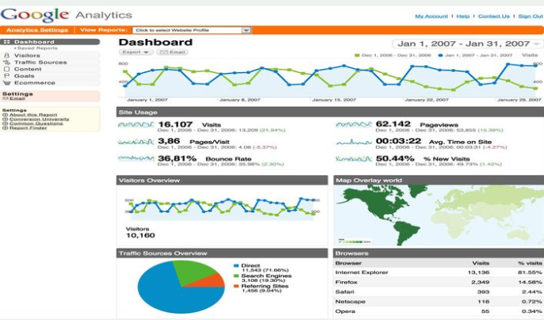
Important Search Engine Optimization Tools
Google Analytics Tools
Google Analytics is the very important tools for every seo professionals. You can easily track website's traffic status and their movement activities through Google Analytics.

Slide 7
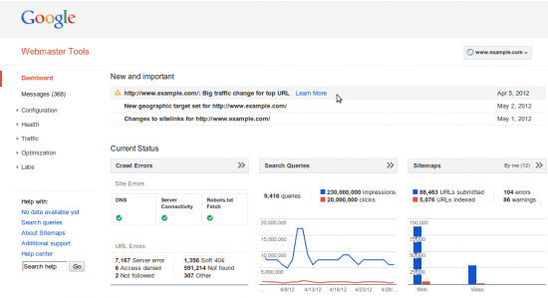
Important Search Engine Optimization Tools
Google Webmaster Tools
Google webmaster tools is the very essential tools for every seo experts. You can easily check your website's health status through this webmaster tools.

Slide 8
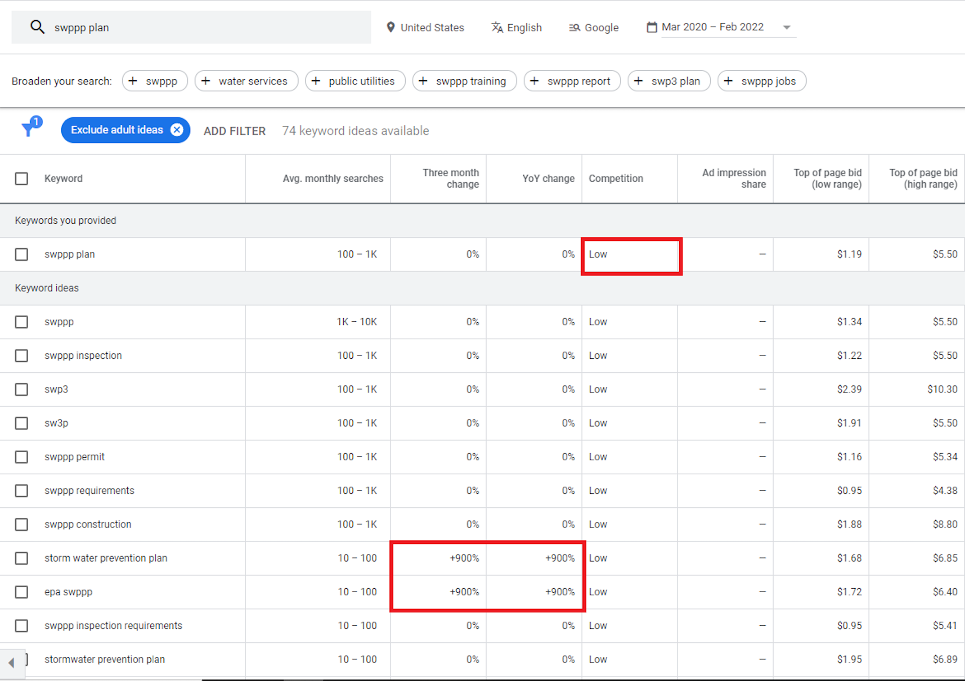
Important Search Engine Optimization Tools
Keyword Planner:
Keyword planner is the place to start when you are doing any keyword research. The keyword planner helps very easy to find keywords for your business.

Slide 9
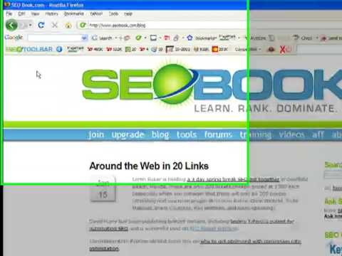
Important Search Engine Optimization Tools
SEOBook Toolbar:
SEOBOOK toolbar is the very important toolbar for seo works. You can easily find website's index, cache, page rank and many more through this toolbar.

Slide 10
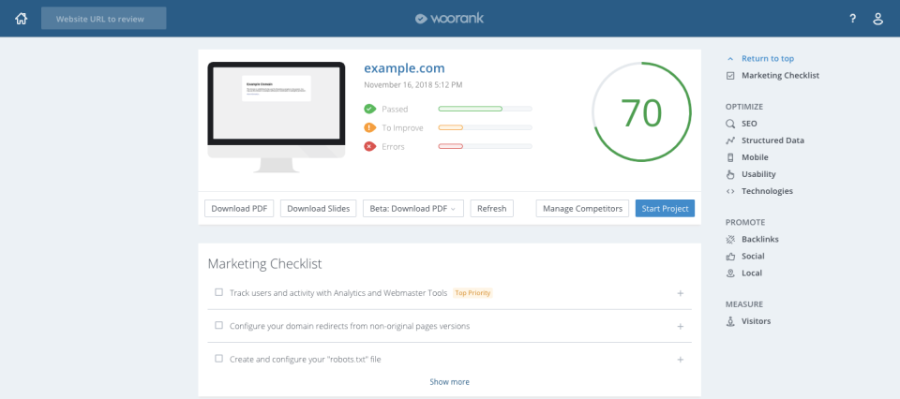
Important Search Engine Optimization Tools
Woorank:
Woorank is the one more important tools for SEO Audits. You can easily seo audit through this tools.

Slide 11
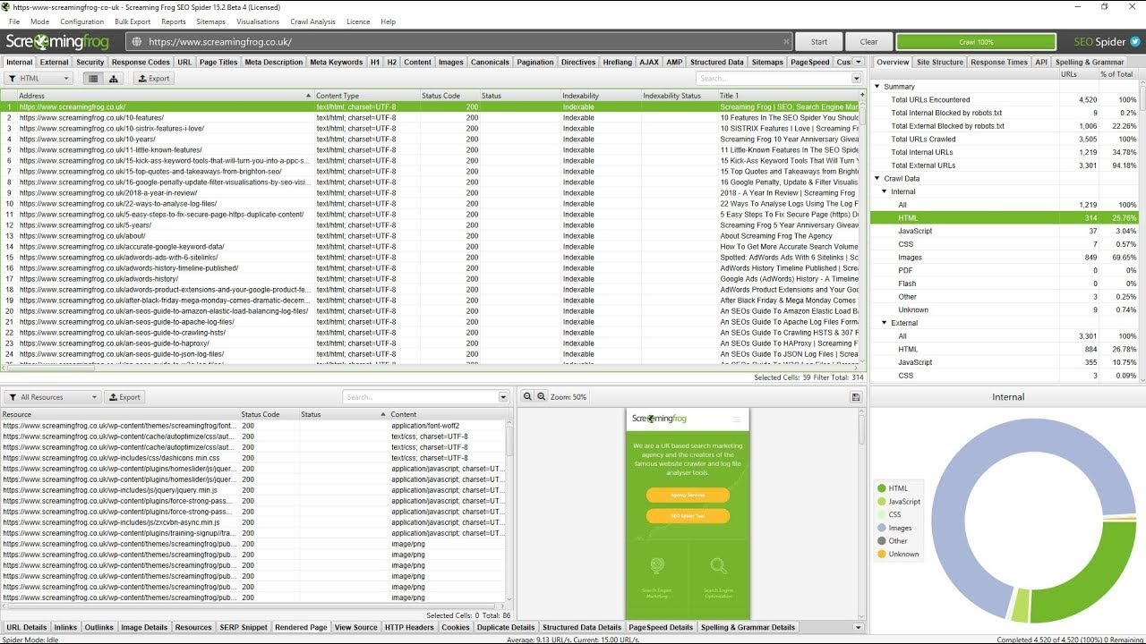
Important Search Engine Optimization Tools
Screamingfrog:
The Screaming Frog is a desktop software which crawls websites’ links, images, CSS, script and apps from an SEO perspective.

Slide 12
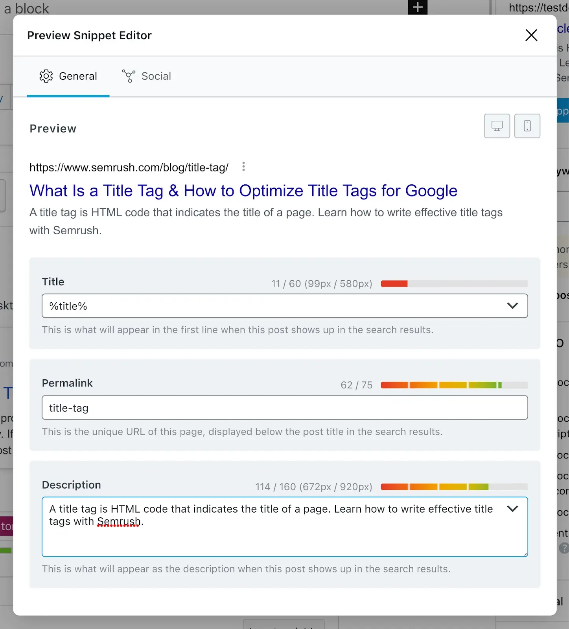
Important Search Engine Optimization Tools
Rank Math
Rank Math is one of the most popular WordPress SEO plugins, with more than 2 million downloads to date.It makes setting up on-page SEO easier. You can create title tags (the title that appears in search results), meta descriptions (brief summaries that may appear in search results), and optimized URL slugs (the end portion of a URL).

Slide 13
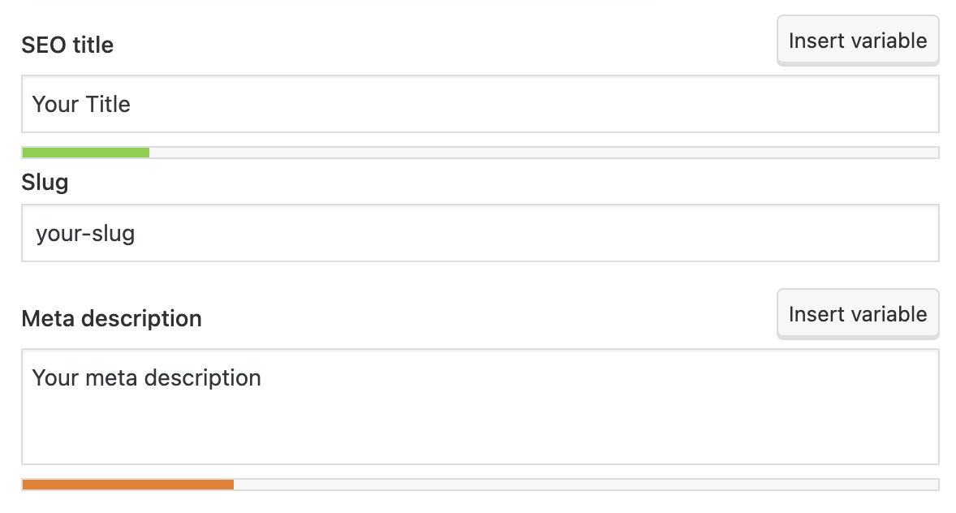
Important Search Engine Optimization Tools
Yoast
Yoast is another handy WordPress plugin with both free and paid options. It’s a staple for many SEOs, as it takes care of the majority of on-page SEO work.

Slide 14
References
Books and Journals
Eric Enge, Stephan Spencer, Rand Fishkin, Jessie C Stricchiola, “The Art of SEO : Mastering Search Engine Optimization”, O'Reilly Media, October,2009.
https://www.hubspot.com/hs-fs/hub/53/file-13221845-pdf/docs/ebooks/introduction-to-seo-ebook.pdf
Fhttps://www.startupgeeks.it/wp-content/uploads/2018/12/ebook-seo-sej-complete-guide-2018.pdf
Video Link-
https://www.youtube.com/watch?v=bLUkIgY8MTE&list=PLjVLYmrlmjGdNxIBIdaDEHtI4gAxaYoq1&ab_channel=WsCubeTech
https://www.youtube.com/watch?v=83RXYrqRLeM&list=PLNfnAKZ4Zsar3Jwb59D0dJeQ-RnsaqpoT&ab_channel=UmarTazkeer
Web Link-
https://www.semrush.com/blog/free-seo-tools/
https://www.tutorialspoint.com/seo/index.htm

